Slide 1
12 – Clean Code – Interface Segregation Principle (ISP)
Based on the CleanCoders videos by Uncle Bob Martin
Rupert Waldron

Slide 2
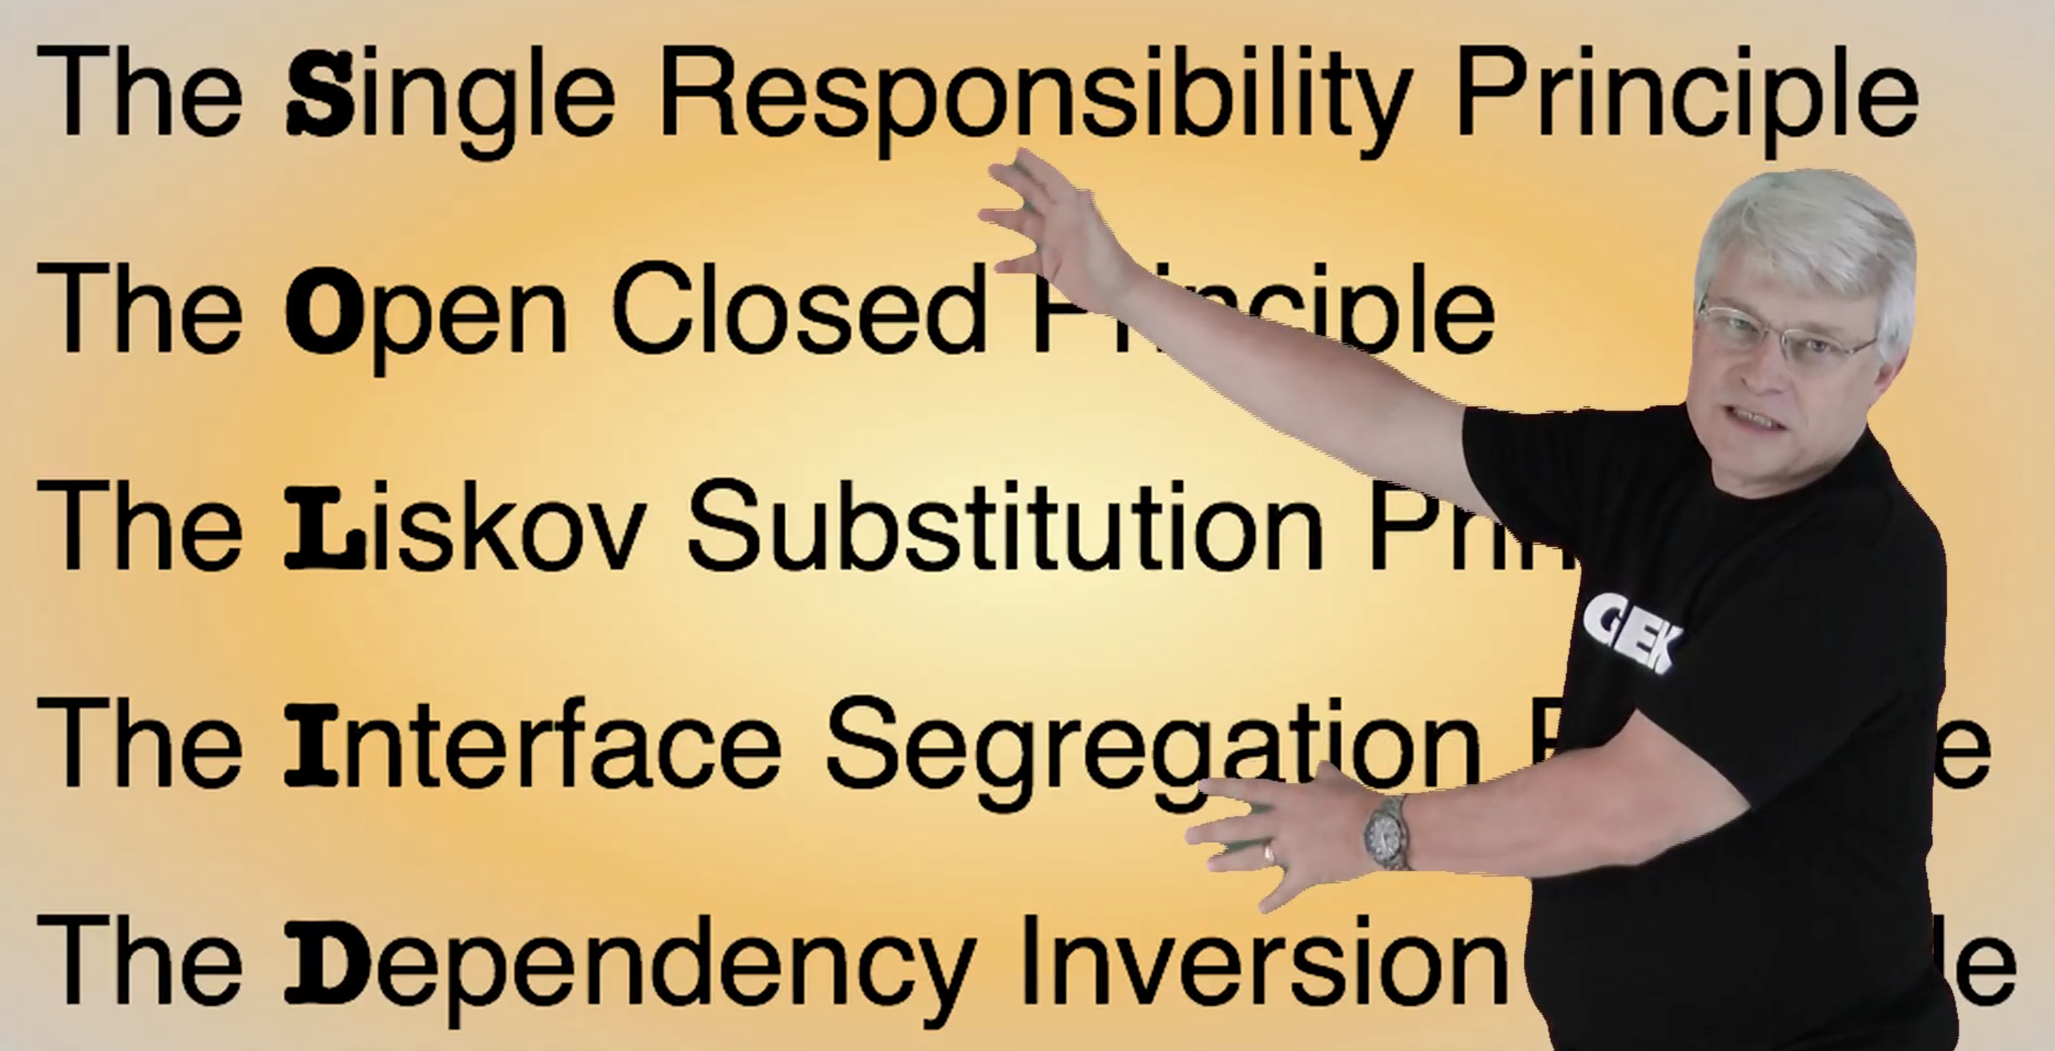
Object Orientated Design is all about Dependency Management
Uncle Bob gives us these dependency management principles that control operations and relationships between classes

Slide 3
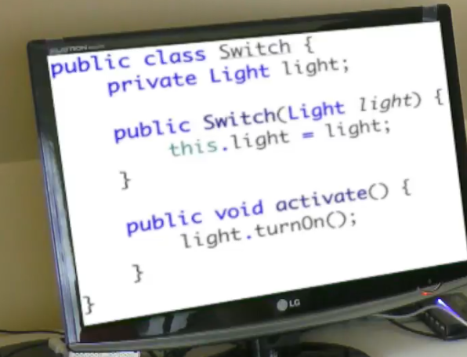
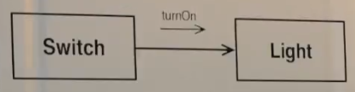
The light switch problem
The implied code
Turn on a light using a swich
Why should the switch know anything at all about the light?

Slide 4
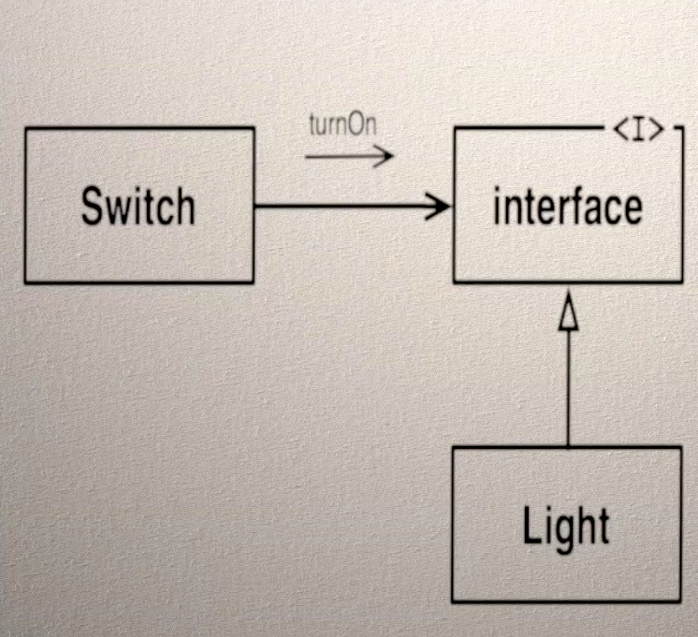
The light switch problem – Add an interface
Interface added… now what to call it?
Lightable?
Notice that the interface doesn’t know anything about the light or anything that implements it. The switch knows about the interface and could control anything.
Inheritance is the strongest of the physical couplings but the weakest of the logical couplings.

Slide 5
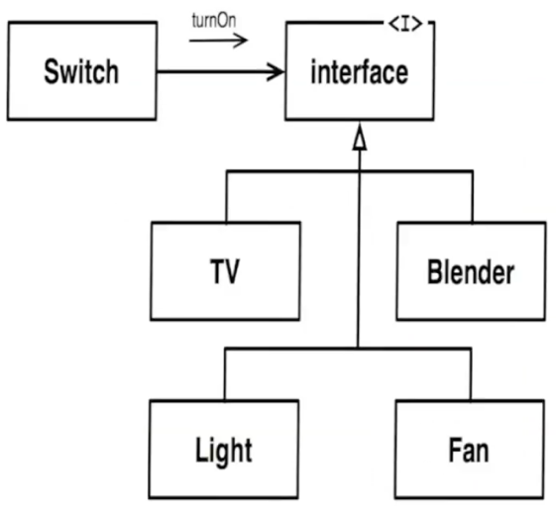
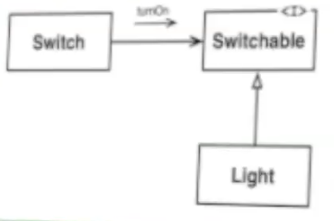

The light switch problem – Add an interface
So what should we name that interface? Use Switchable; the name of an interface has more to do with its users than its implementers.
Note that Switch and the interface can be deployed separately

Slide 6
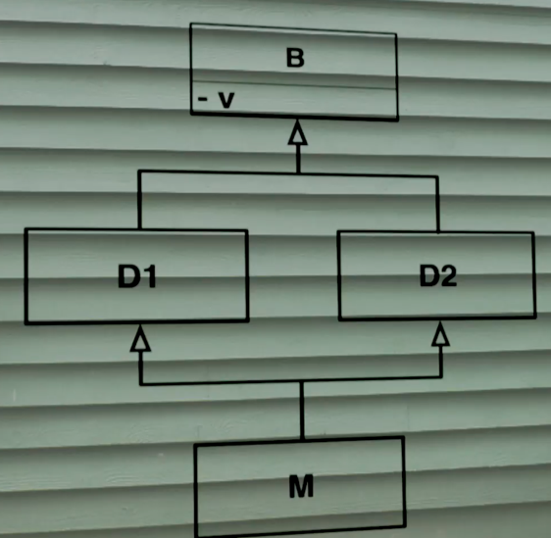
So What are interfaces?
C++ - Virtual Abstract Class
Class theInterface {
Public:
virtual void turnOn() = 0;
}
Why do we have interfaces in Java and C#?
To avoid multiple inheritance from classes and so avoid the deadly diamond of death.
How many v fields should M inherit?

Slide 7

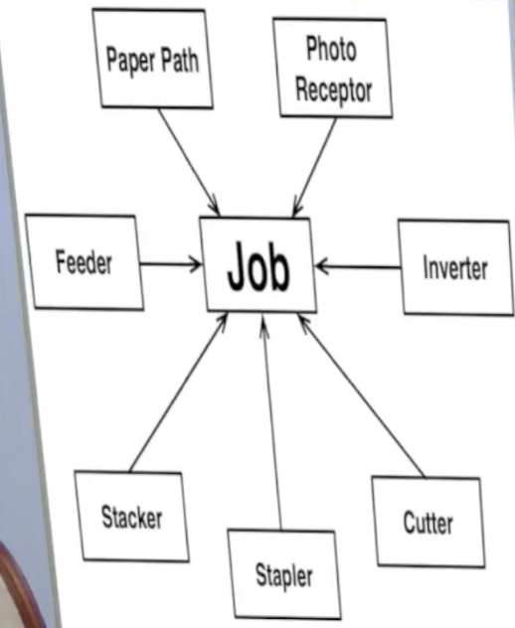
Fat Classes
Printer example with the Job Class. The other classes use the Job class for different reasons resulting in 100s of methods in the Job Class. The Job class has a lot of reasons to change and has a huge fan-in which resulted in re-building all the classes for each change – compile time could be very long in the early 90s.
All the calls to job class were made by the other classes for different reasons and they called different methods – how can we make this better?
There were hundreds of different methods in this job class – it had a lot of reasons to change

Slide 8
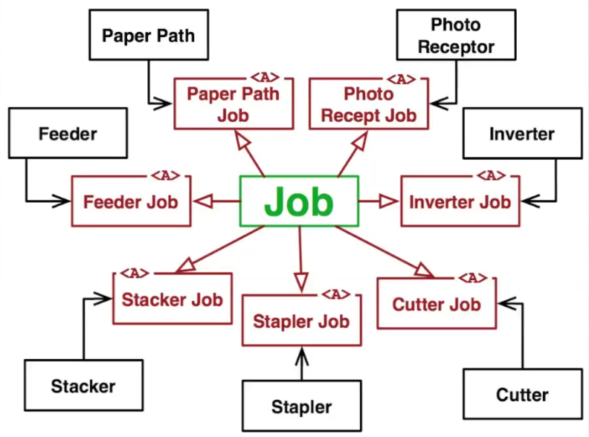
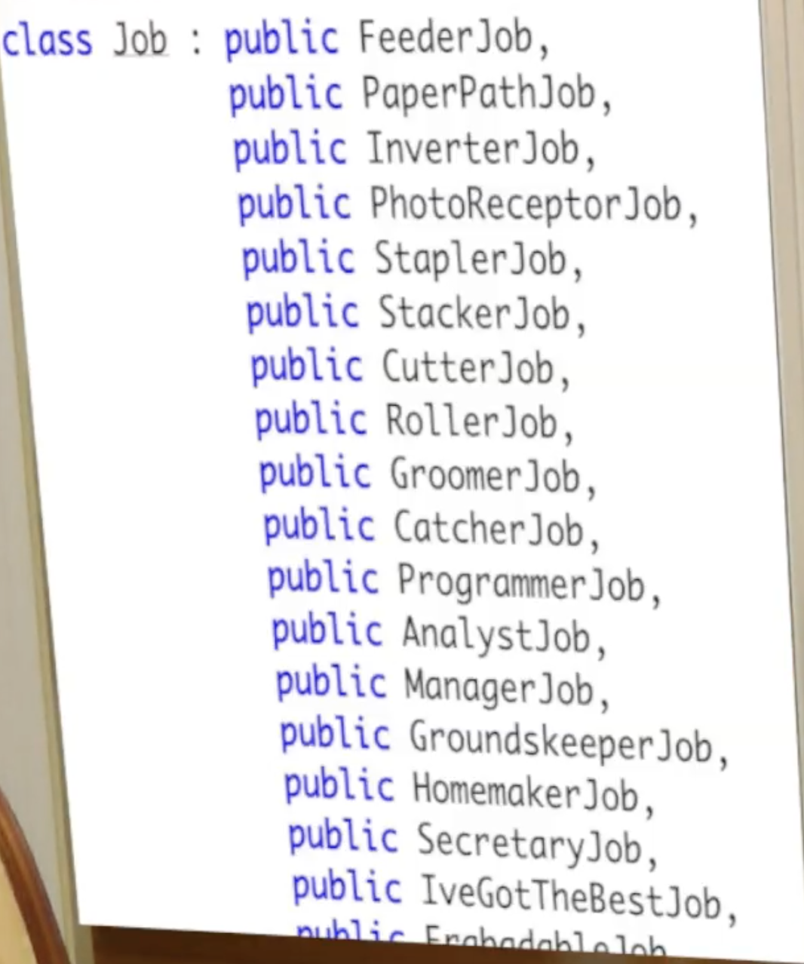
Solution..
If a method did need to be changed in the job class then only those classes that used those methods would need to be changed.
Unfortunately the compiler designers assumed that no one would ever need to inherit from more than one base class – the compiler choked. Doh

Slide 9
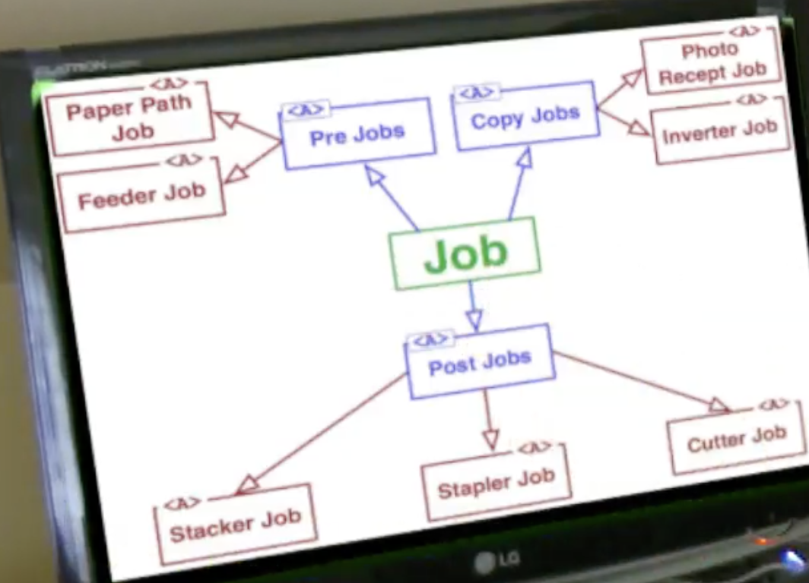

The actual solution due to compiler limitations
Compile times shrank considerably resulting in increased ability to make changes
The interface segregation principle solves the problem of fat classes.
There was no way to split Job up as all the data had to be managed in one place.
Fat classes cause lots of coupling, best approach is to separate out the clients using interfaces which are more logically coupled. These interfaces contain only the methods the clients wish to call.
Then multiply inherit this interfaces into the fat class – then clients can be placed into separate components – deployed separately and developed separately.

Slide 10
ISP – Code Smells
Passing in a constructor argument that you don’t actually use.
Building a complex data structure just to run a test
Wire up the webserver and connect to the database just to test a business rule.
Load up jar file to satisfy some part of a library you aren’t going to use.
To write a test to walk through the login process to update a business rule
To call a function you had to call two other functions first but you didn’t know or care what they did.
Don’t force users to depend on things they don’t need to know about.

